Slide 1
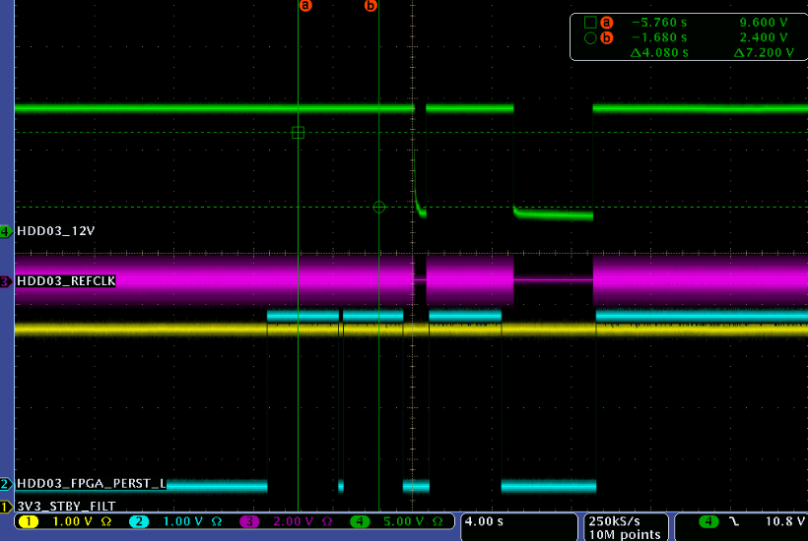
Q1
Q2
Notes:
Three signals under the observation are 12V which is 12V_EN,PERST , REFCLK ( CTL_PL and CTL_MN) on PCIe card,
The PCIe card used for these observations is QTL 1688-04-017.
12V_ EN Component U86 Pin 2
Device_PWRGD Component U80 Pin 4 --
REFCLK Component U77 Pin 1

